Slide 1

The Danger of Falling Away!
Scripture Text: Hebrews 6:1-6
Old way of Life
New way of Life

Slide 2



Slide 3

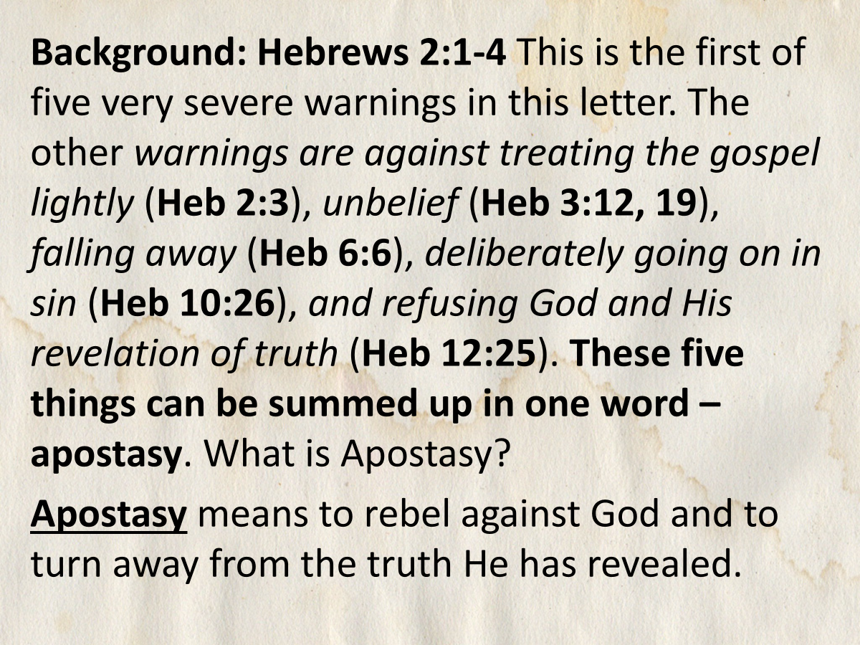

Slide 4

“Spiritual - Falling Away”– Except there be a falling away first” comes from 2 Thess. 2:3 KJV. It is part of a warning from the Apostle Paul that the Day of Christ (the return of Jesus) will not happen until a massive, widespread rebellion against God (apostasy) occurs, and the “man of sin” (Antichrist) is revealed.

Slide 5

What does the
Bible mean by falling away?
When a person becomes apostate, they rejected the faith that they once professed; they have fallen away from the faith.

Slide 6

“Let no one deceive you”– there will always be deceivers who want to turn believers away from one Biblical truth or another.
Compare Matt 24:4-5; Rom 16:17-18; Eph 5:6; Col 2:4.
We need to know the Word of God and be always alert.

Slide 7


Slide 8
What the Bible Says About Falling Away: “Falling away” refers to a failure to maintain faith or adherence to God, often described as apostasy or a deliberate turning away from the truth of the Gospel (2 Thessalonians 2:3).
It signifies a spiritual decline where one abandons their commitment to Christ and the teachings of Scripture.

Slide 9

In Hebrews 6:4-6 it underscores the seriousness of such a departure, stating that those who have tasted the goodness of God yet fall away have subjected themselves to a dire state that makes restoration exceedingly difficult.

Slide 10

These passages highlight that falling away is not merely a lapse in faith but rather a severe, conscious choice to renounce the truth and presence of God. Moreover, the notion of falling away serves as a cautionary tale throughout the New Testament, urging believers to remain vigilant and steadfast in their faith. (1 Peter 5:8-9)

Slide 11
Similarly, the parable of the sower in Matthew 13:20-21 illustrates how some receive the Word with joy but fall away when faced with persecution or hardships. This idea underscores that the journey of faith requires:
  Perseverance,
  Grounding in Truth,
  Relationship with God through Christ.

Slide 12
Ultimately, the biblical exhortation against falling away encourages believers to seek spiritual maturity and resilience in their faith, ensuring they remain anchored amidst trials and tribulations. The theme of falling away is further examined in the warnings given throughout the New Testament about the destructive nature of false teachings and the allure of sin. For instance, in Galatians 5:4, Paul admonishes the believers that if they attempt to be justified by the law, they fall away from grace.

Slide 13
This implies that an individual’s departure from the core message of grace through faith can lead to a disconnection from the salvation that Christ offers. It highlights how subtle theological errors can lead believers down a path of spiritual estrangement—a theme reiterated in various epistles. Additionally, in 1 Timothy 4:1, it is stated that in the latter days, some will abandon the faith and pay attention to deceiving spirits and things taught by demons.

Slide 14

HOLD FAST!
The call to hold fast to sound doctrine and to be anchored in God’s Word is paramount in preventing a falling away, which is portrayed not just as an individual’s personal struggle, but as a communal responsibility among the body of Christ to uphold one another in faith.

Slide 15
SCRIPTURE: EXAMPLES
Galatians 1:6-7 “Moved away from God!”
Galatians 2:11-13 “Departing from Truth to Traditions.”
Hebrews 5:11-14 “A call to Spiritual Growth.”
Philippians 3:12-16 “Press toward the Goal.”
Hebrews 10:26-31 “Remain faithful.”
Hebrews 10:32-39 “Our example of when we first believed!

Slide 16

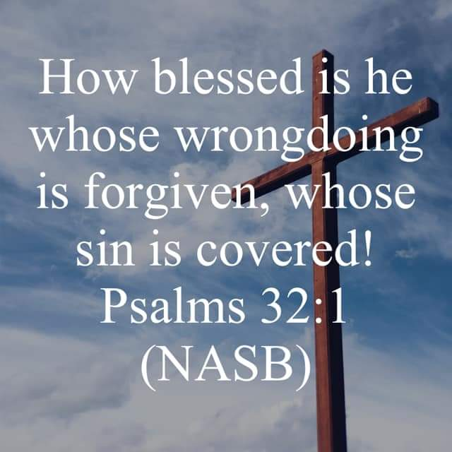
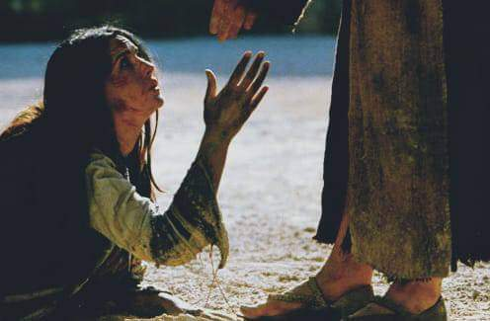
Let us Pray

