Slide 1

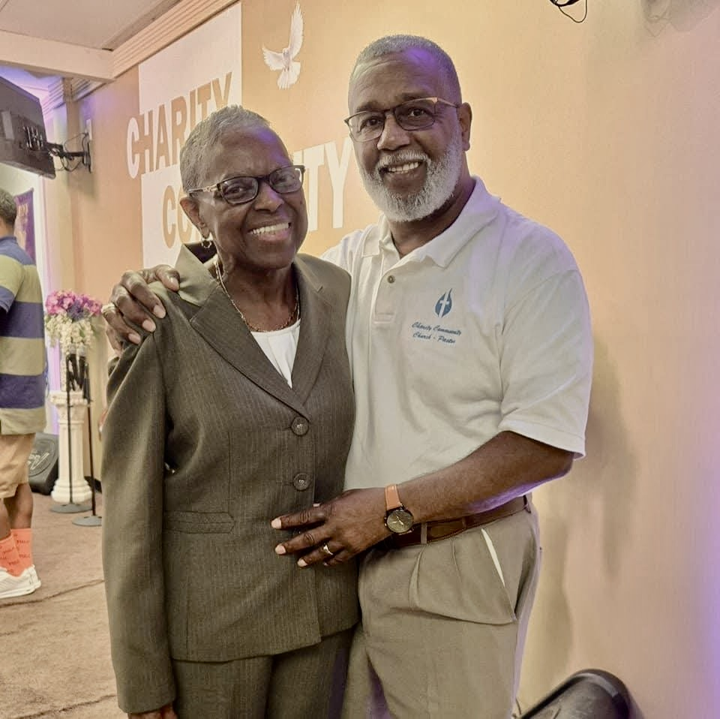
Join us this Sunday for
Family and Friends Day!
Charity Community Church
Worship time: 11am
1950 Old Cuthbert Road, Cherry Hill, NJ 08034
Philippians 4:6-9

Slide 2

Introduction
Phil. 4:6-9
What is heavy on your mind today?
What concern is weighing you down?
If you could let one thing go what would that be?

Slide 3
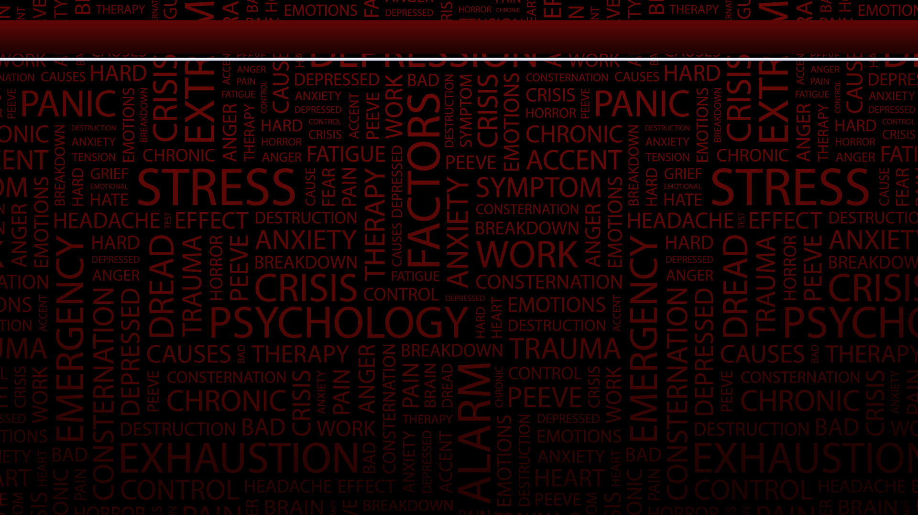
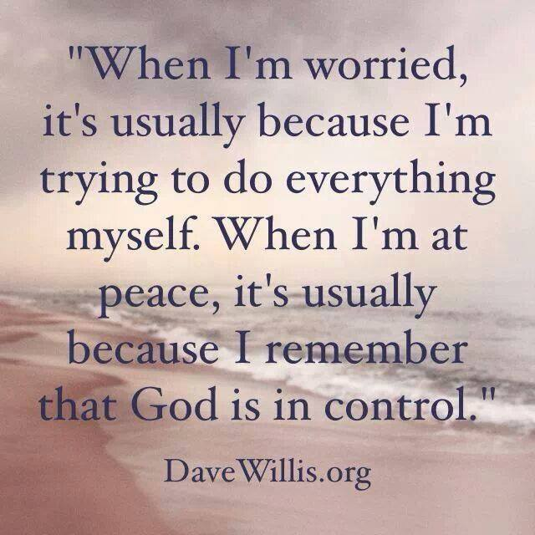

Slide 4

God’s way for continual peace of mind and heart
Here is God’s way for us to have continual peace of mind and heart in all circumstances of life (except when sinning – that will always rob believers of their peace).
“Anxious”– anxiety reveals that trust in God or understanding of His truth is weak. Worry and faith are like oil and water; they do not mix. See Matt 6:25-34.

Slide 5
Refuse To Worry!
“Nothing”– we should refuse to worry even in the most difficult or alarming situations. If we are believers, God is in us, near us, around us, with us. He is our Father who loves us beyond our ability to grasp and has power without limit to use in our behalf. Our part is to cast all our care on Him by faith and to rest in Him and in His promises – 1 Pet 5:8.

Slide 6


Slide 7
Different Kinds of Prayers
There are different kinds of prayer and Paul here uses different words to indicate some of them.
“With thanksgiving”– see notes at Gen 18:32; Lev 7:12-13; Ps 7:17; 50:14-15; Eph 6:18; 1 Thess 5:17-18; Heb 13:15. Without giving thanks to God can we imagine that the other forms of prayer mentioned here will be effective?
“Requests...to God”– not to people. See also Matt 7:11.

Slide 8
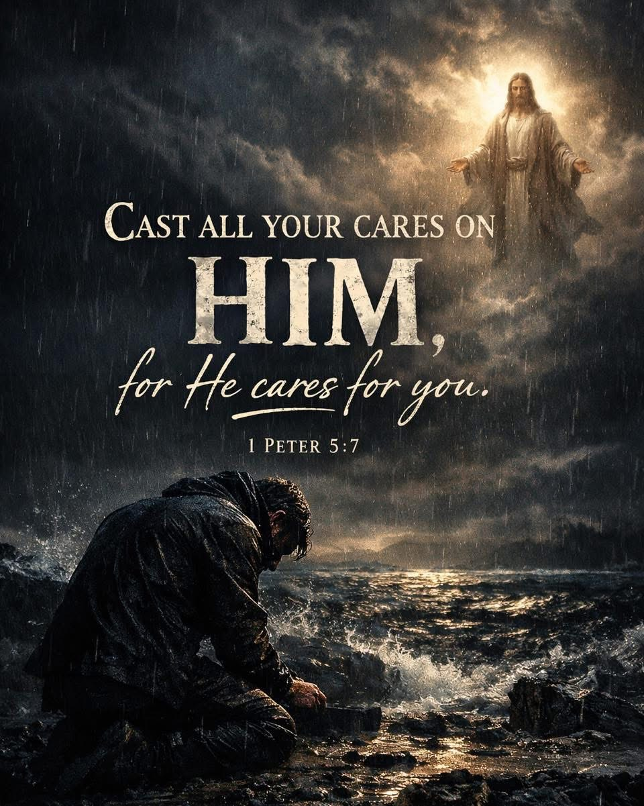
The Lord wants us to

Slide 9
The Peace of God
4:7 The peace of God means here the peace He gives. It is like His own peace. God does not worry about anything. Peace in us is the result of submission to God and trust in Him – Isa 26:3. See also John 14:1, 27; 16:33; Col 3:15. This peace is like the “rest” Jesus promised in Matt 11:28-30.

Slide 10
Believers can have Peace
Believers can have peace in situations where others could never have it, and they will not be able to understand how they have it and will wonder at it. This peace of God will act as a guard at the door of their minds and hearts, and will keep out the anxieties, worries, and disturbing thoughts that so greatly trouble those without this peace.

Slide 11
“Think on these things”
4:8 “Think on these things”– our mind, our thoughts are exceedingly important in the spiritual life. To a large extent they will determine our actions. Believers should have minds made new – Rom 12:2. They should set their thoughts on heavenly things – Col 3:2. They should keep their thoughts on the things of God’s Word. See Ps 1:1-2.

Slide 12
Sinful things, worldly things, evil things
Sinful things, worldly things, evil things are attractive to the sinful nature in us – Gal 5:16-17. If we let our thoughts dwell on such things we may be overcome with the desire for them. If our thoughts are always on true, pure, and excellent things we will be better able to reject and subdue sinful desires.

Slide 13
We should be very Careful
So, we should be very careful what we read, what things we watch, what kind of music we listen to, where we allow our imaginations to take us. If we fill our minds with things unworthy for believers in Christ we may soon be living lives unworthy of Christ.

Slide 14
Paul forth as an Example
4:9 God set Paul forth as an example to believers. We can learn from him what we should think, believe and practice – Phil 3:17.
“God of peace”– Rom 15:33; 16:20; 1 Thess 5:23; Heb 13:20. Only if the God of peace is with us can we have the peace of God in us – v 17.

Slide 15
So, how do we renew our minds?
Immerse yourself in Scripture. The Bible isn’t just information; it’s transformation.
Meditate on God’s Word. Think deeply about it. Turn it over in your mind. Let it sink in.
Speak truth out loud. Declare Scripture over your life. Hearing truth strengthens faith.
Capture rogue thoughts. When a thought doesn’t align with God’s truth, take it captive.
Pray for transformation. Ask God to help you see situations, people, and yourself as He does.

Slide 16
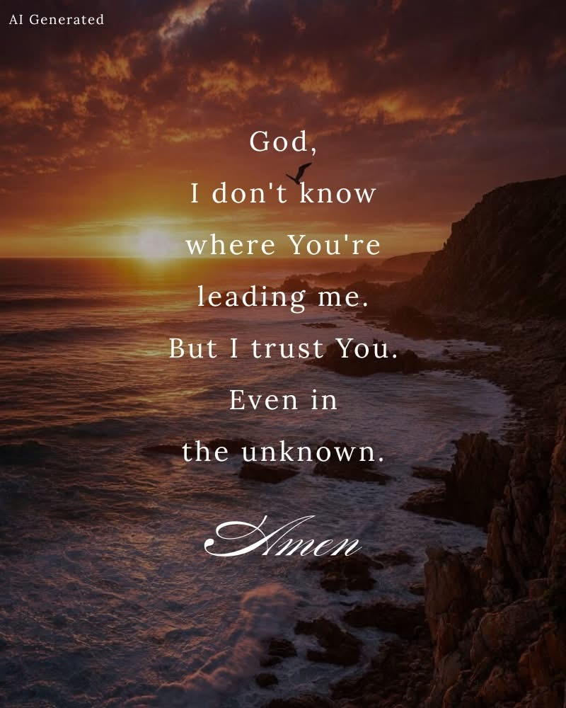

Slide 17


Slide 18
Philippians 4:6-9

