Slide 1

Behold The Lamb!
Text: John 1:29-34

Slide 2
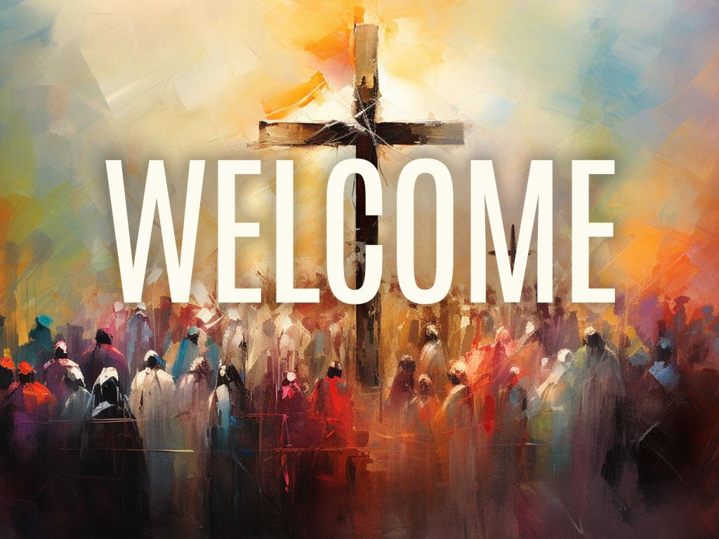

Slide 3
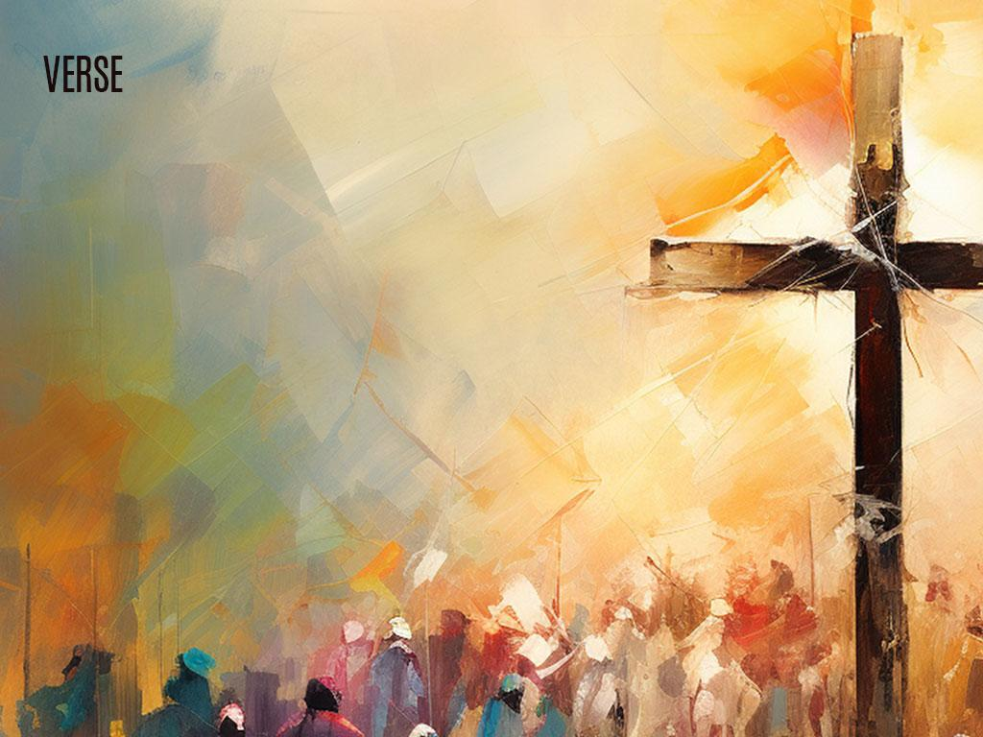
The Lamb in the Garden.
Gen. 3:21, Romans 5:12-21 – The Sacrificial Lamb.

Slide 4


Slide 5
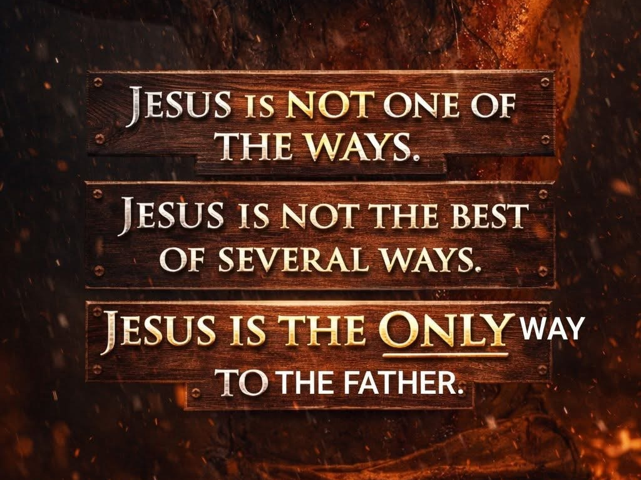

Slide 6
The Passover Lamb.
Exodus 12:1-13 – The Sacrificial Lamb.

Slide 7
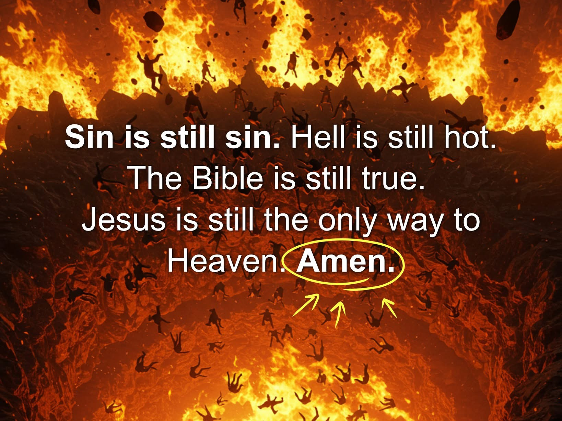

Slide 8
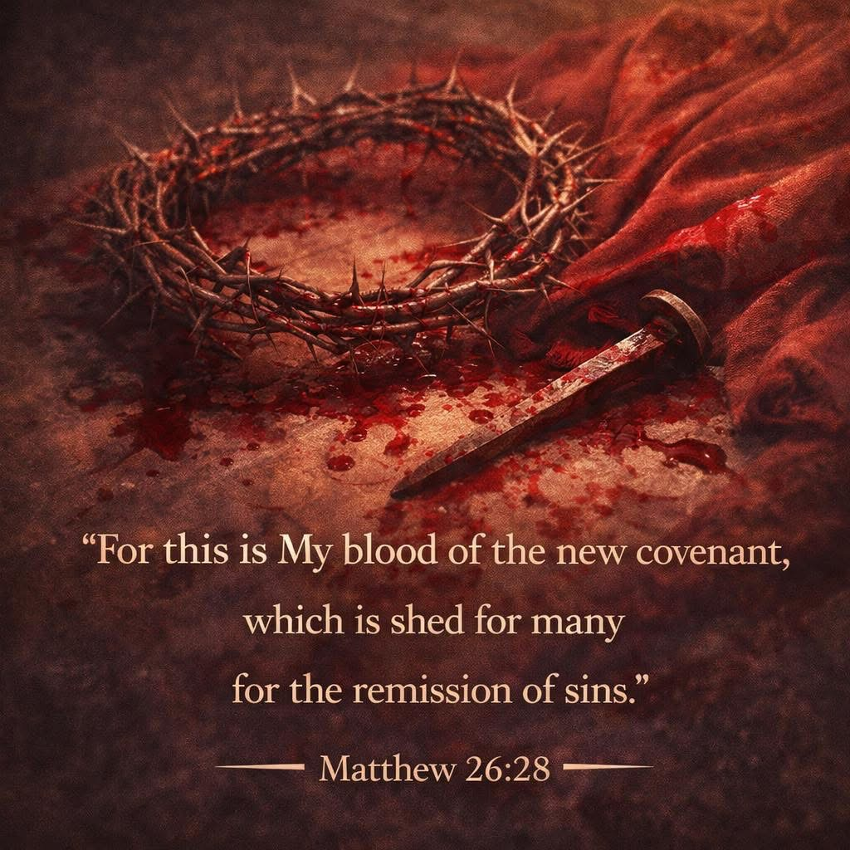

Slide 9
The Cross.
John 1:29, John 19. The Final Sacrificial Lamb.

Slide 10
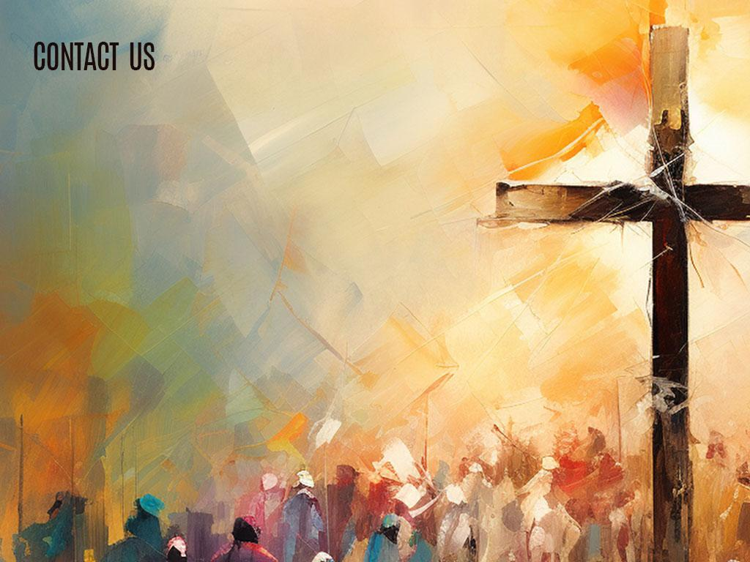
Why Behold the LAMB of God?
He is God’s Sacrifice for sin. Hebrews 1:1-4
He paid our sin debt. Romans 5:1-11, 6:23
He is the glory of God in flesh. John 1:1-14
No other way to God. John 14-6
No other Name. Acts 4:12
We pass from death to life. Romans 6:23
We are now new creatures. 2 Cor. 5:17-21

Slide 11


Slide 12


Slide 13
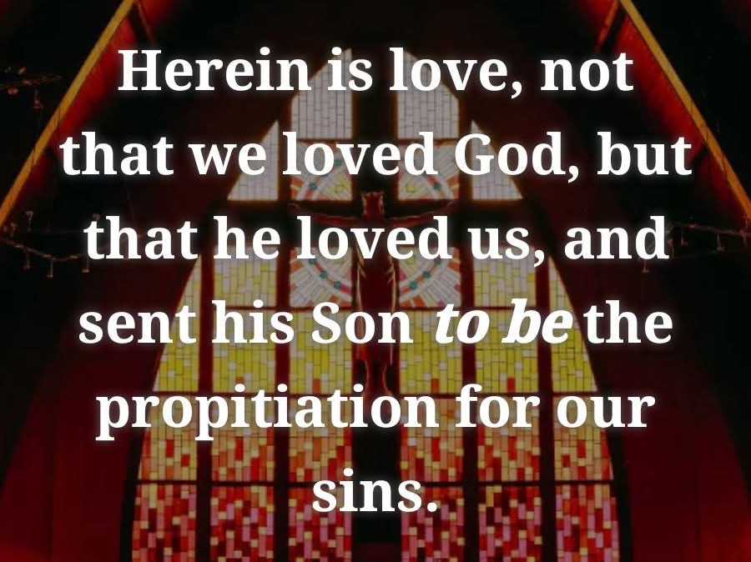

Slide 14
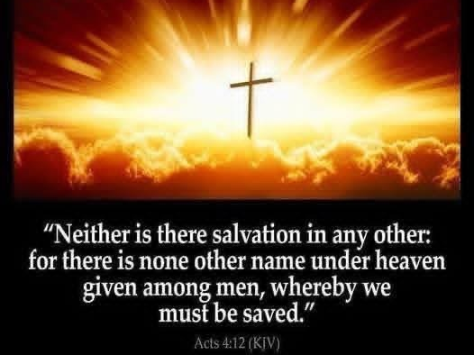

Slide 15

Today
Let us Pray: Today is day for you to make a choice about taking Christ Jesus as your Lord and Savior!
Jesus can save your soul!
Jesus is calling you! Will you come today?
Jesus offers you new life, another opportunity to start over.
He has the peace, forgiveness, and freedom from sin you desire. Come! Come! Come today!!!

Slide 16

Come to JESUS now!

Slide 17


Slide 18


