Slide 1

JESUS IS OUR FOUNDATION!
The Four Habits That Fuel Spiritual Growth!

Slide 2

Background
Scripture
Col. 2:6-7
How Deep are your ROOTS?

Slide 3

Growth is rarely the result of one extraordinary moment. It's usually the result of many ordinary moments lived faithfully.
Think about a tree. It doesn't become tall overnight. It grows because day after day, its roots draw nourishment from the soil. The growth is almost invisible, yet over time it becomes undeniable.
Spiritual growth works the same way.
J
E
S
U
S

Slide 4
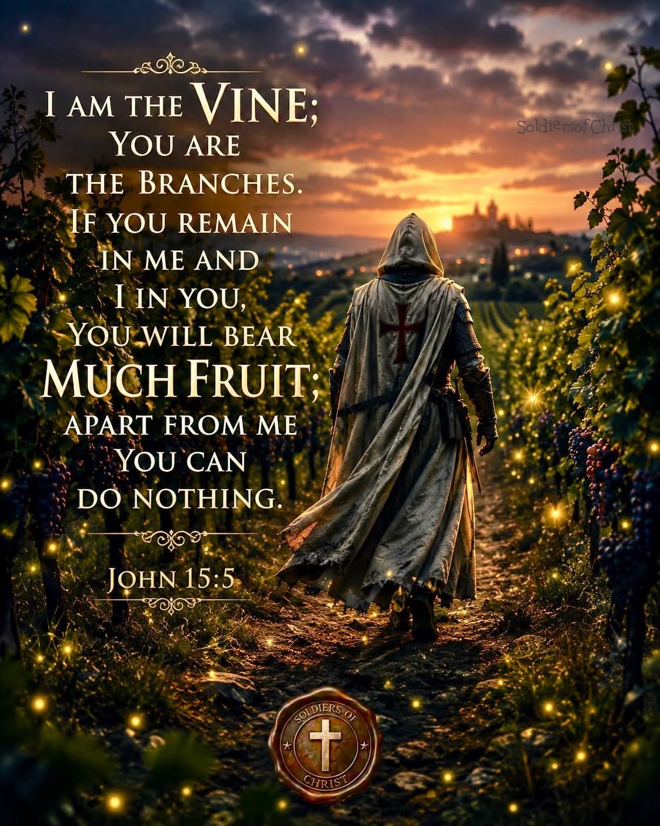

Slide 5

Many Christians long to become spiritually mature, but they look for dramatic experiences instead of developing daily habits. While God certainly meets us in powerful moments, lasting maturity is usually formed through consistent obedience.
J
E
S
U
S
Romans 10:17

Slide 6

Jeremiah 29:11-14

Slide 7
Part 2
JESUS IS OUR FOUNDATION!
The Four Habits That Fuel Spiritual Growth!

Slide 8

(Galatians 1:6-10)

Slide 9
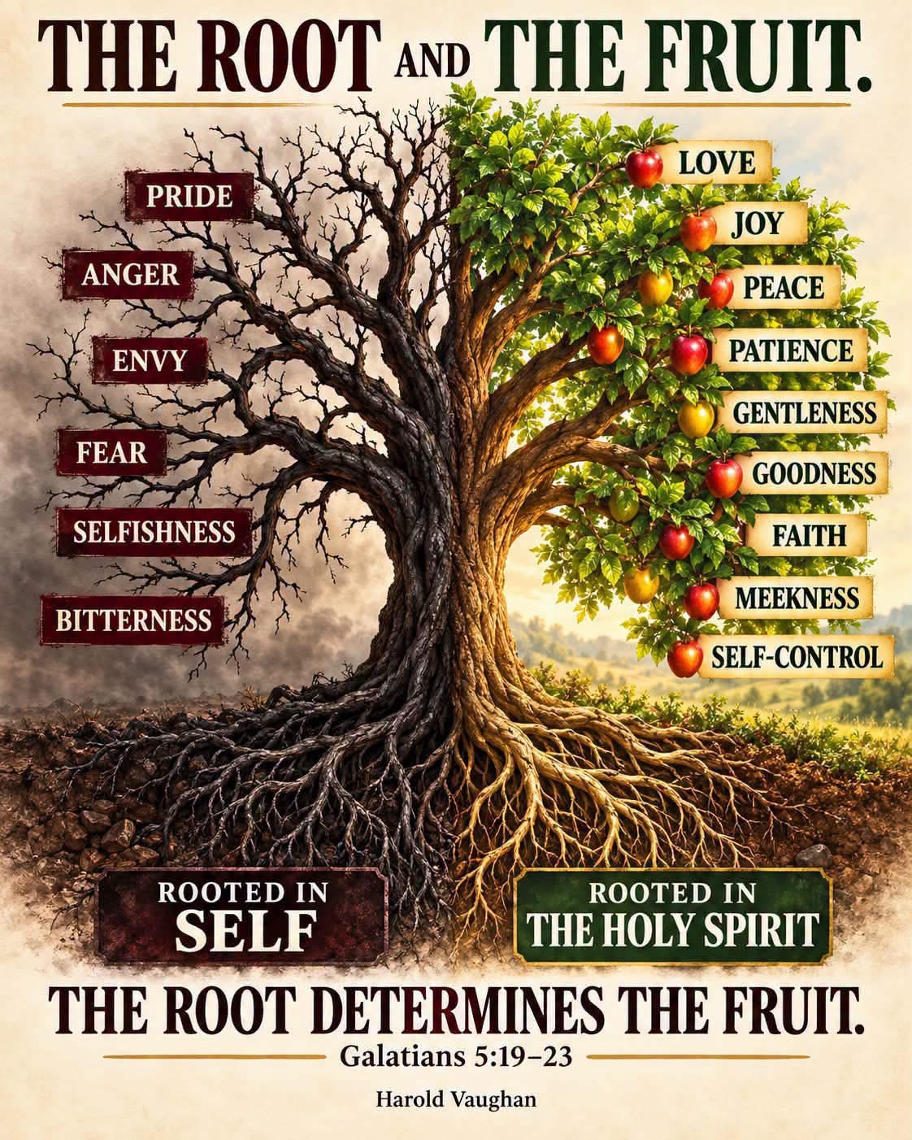

Slide 10
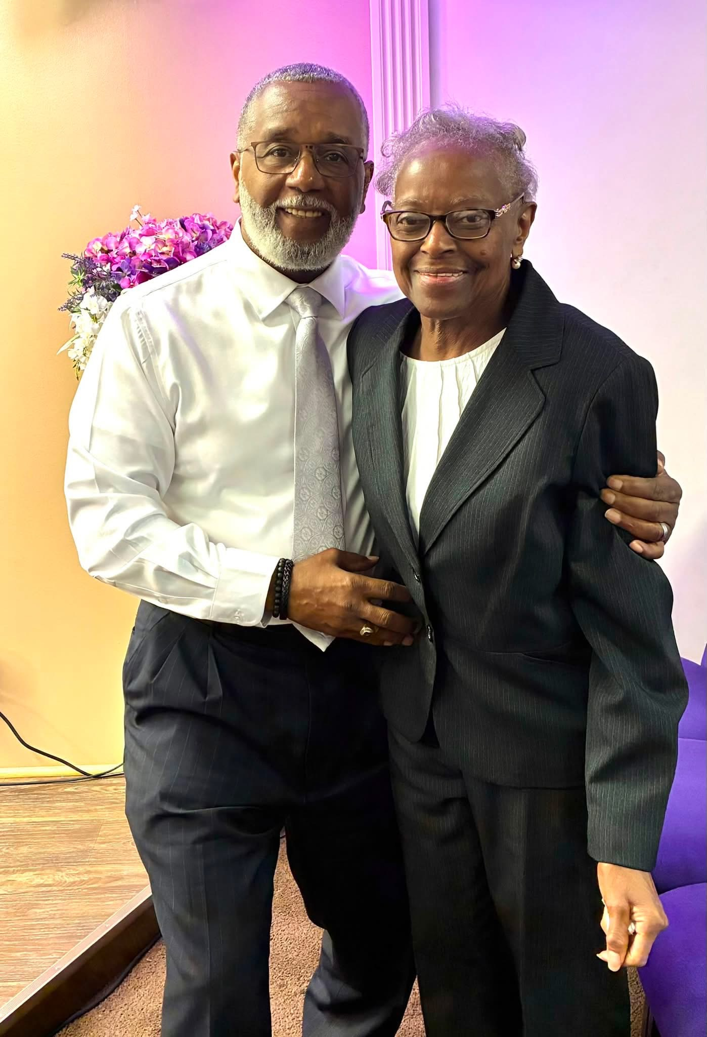
How do you know you are growing in Christ Jesus?

Slide 11


Slide 12

There are Four Habits that create an Environment for Spiritual Growth:
J
E
S
U
S
1. Thirst & Hunger
2. Structure
3. Discipline
4. Consistency

Slide 13
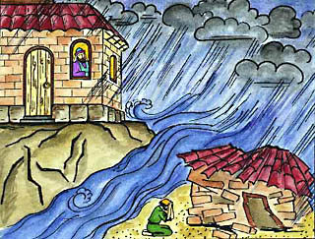
Scripture Text: Matthew 7:24-29; 1 Cor. 3:10-20, 6:9-30, Eph. 2:11-22
SAVED
John 16:33
LOST

Slide 14
The First is Thirst and Hunger.
Every healthy relationship begins with desire.
David wrote, "As the deer pants for streams of water, so my soul pants for you, my God." Psalm 42:1 (NIV).
Spiritual growth begins with a heart that genuinely wants God. (Hebrews 11:6)
How bad do you want God?

Slide 15

The Good News is that even if your spiritual appetite has grown weak, you can ask God to renew it. He delights in awakening a fresh desire for His presence. (Joshua 1:6-9)
Don't settle for merely knowing about Him when you can know Him personally.

Slide 16


Slide 17
The Second Habit is Structure.
Healthy things grow best in healthy environments.
If you only pray when you happen to remember, or read your Bible only when you feel inspired, your spiritual life will often be inconsistent. Growth flourishes when we intentionally make room for God in our schedules.
Make time for GOD!

Slide 18
Jesus Himself modeled this. Throughout the Gospels, we see Him regularly withdrawing to quiet places to pray. His relationship with the Father wasn't left to chance—it was a priority.
What would happen if you intentionally scheduled time with God each day?
Not because He needs an appointment, but because your heart does.

Slide 19
The Third Habit is Discipline.
There will be days when you don't feel like praying.
Days when opening your Bible seems difficult.
Days when worship feels dry.
Those are often the days when discipline matters most.
Romans 12:1-2

Slide 20

Love is not sustained by feelings alone. Neither is spiritual growth.
Discipline means choosing what matters most over what feels easiest. It's saying, "Lord, I'm tired, but I still want to meet with You."
Those quiet decisions, repeated over time, become the building blocks of spiritual maturity.

Slide 21

But over weeks, months, and years, those ordinary moments shape an extraordinary life.
Jesus compared God's Kingdom to a mustard seed—the smallest of seeds that eventually grows into a large tree. Growth is often slow enough that we hardly notice it, yet powerful enough to transform everything.

Slide 22
Don't despise small beginnings.
A single day of prayer won't change everything.
One sermon won't mature your faith.
One act of obedience won't complete God's work in you.
But daily faithfulness, empowered by the Holy Spirit, will steadily transform your life.
Perhaps you've been discouraged because your growth feels slow.

Slide 23

Take heart.
God is far more interested in your direction than your speed.
Remain hungry for Him.
Create space for Him.
Choose Him even when it's difficult.
And keep showing up.

Slide 24


As you do, you'll discover that spiritual maturity isn't built on occasional moments of inspiration—it is cultivated through a lifetime of faithful devotion to Christ.
1 John 5:14-15

Slide 25


Members
Members

Slide 26


Slide 27
Prayer: Psalms 119:105
Father God, thank You for inviting us into a deeper relationship with You. Give us a Greater Hunger for Your Presence and Your Word. Help us to create space for You in our daily life, to remain disciplined even when we don't feel like it, and to stay consistent in seeking You.
Form Christ in us through these daily habits, and let our life continually grow in faith, love, and obedience. Amen!

Slide 28
There are Four Habits that create an Environment for Spiritual Growth:
J
E
S
U
S
1. Thirst & Hunger
2. Structure
3. Discipline
4. Consistency

Slide 29

The End!

Slide 30


Slide 31
