Slide 1
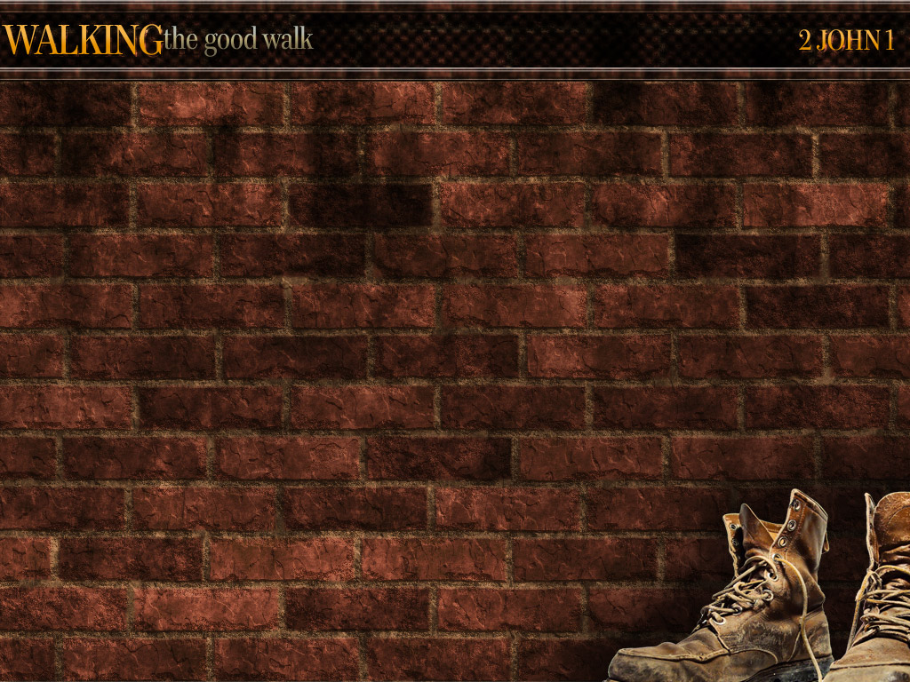

1 John 2:15-17 A warning about the World!

Slide 2

Come Out And Be Separated!
Scripture: 2 Cor. 6:14-18

Slide 3
Background: 2 Cor. 6:14-18 Paul sets forth this very important truth – believers in Christ are the special people of God and they should behave accordingly.
Compare Deut. 7:3-6;
1 Pet 2:9-12; John 17:6-11.

Slide 4
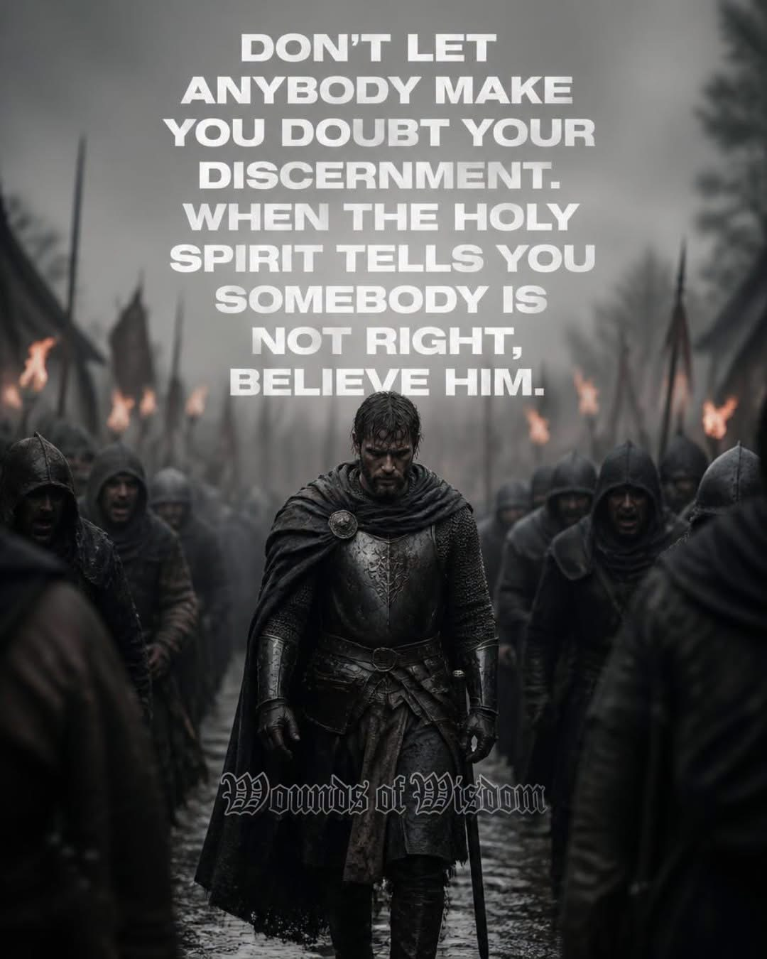

Slide 5
Believers are yoked with Christ (Matt 11:28-29), so they must not yoke themselves with those who reject Christ. This certainly forbids marriage between believers and unbelievers (see also 1 Cor 7:39; Ezra 9:1-2.
It also forbids fellowship with false teachers who preach a perverted gospel or who deny some of the basic truths of the Bible.

Slide 6

Verse 14 gives a principle which applies to all believers. They must not form any close alliances with unbelievers. “Yoked” indicates being joined very closely together in a
common aim and
work. See Deut. 22:10.

Slide 7
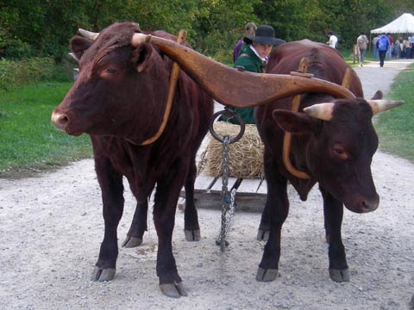

Slide 8
Of course, Paul is not forbidding believers to work in a place where unbelievers work, or to hire unbelievers to work for them. And it does not mean that they should cut themselves off from all contact with unbelievers (1 Cor 5:9-11). Paul himself associated with unbelievers in order to win them to Christ.

Slide 9


Slide 10
But here he forbids close fellowship and common goals with unbelievers, any relationship which would lead to a compromise of Bible principles or endanger the fellowship of believers with Christ. Any believer who acts against this principle is inviting trouble.

Slide 11


Slide 12
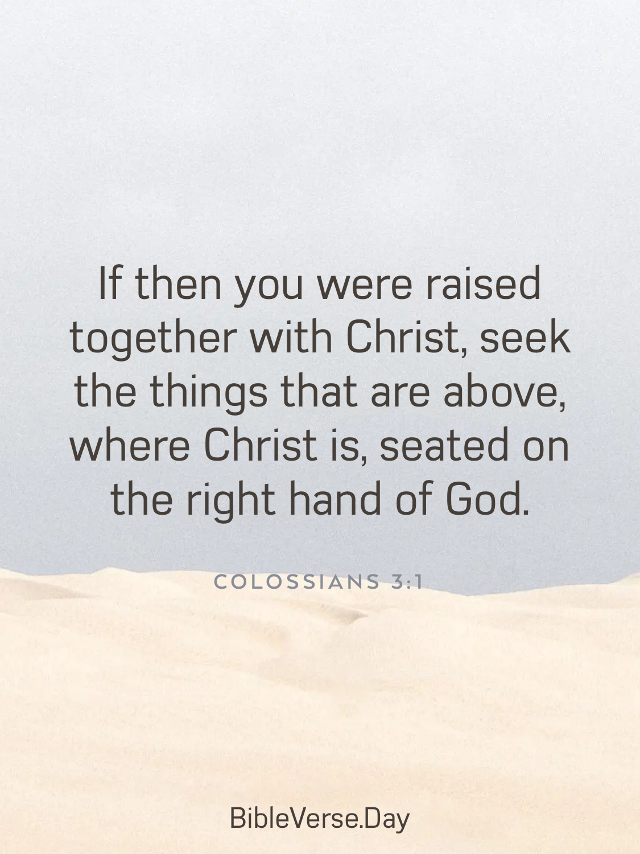

Slide 13
In vs 14-16 Paul asks five questions to show (1) how foolish and wrong it is for believers to join themselves to unbelievers. Things and persons which have nothing in common should not be treated as if they did have. (2) Separation from all evil and all evil persons is God’s command for His people (v 17).

Slide 14


Slide 15
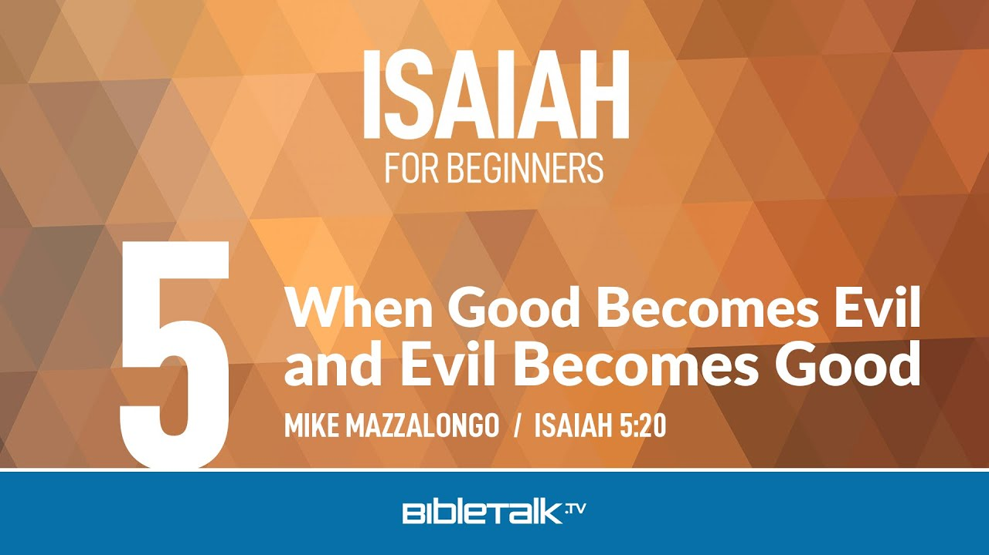

Slide 16
6:14 (3) “Light”– believers are in the light, love the light, and are children of the light (Matt 5:14; John 3:21; 8:12; Eph 5:8; 1 Thess 5:5).
The situation of unbelievers is just the opposite of all this (John 3:19; Eph 6:12; 1 John 2:9, 11). Then should they willingly engage in joint ventures?

Slide 17
6:15 (4) “Belial”– this name comes from a Hebrew word meaning worthless and wicked. Paul uses it here as a name for Satan.
Believers are joined to Christ; unbelievers are joined to Satan (Eph 2:2; John 8:44). How then can believers even dream of joining themselves to unbelievers?

Slide 18
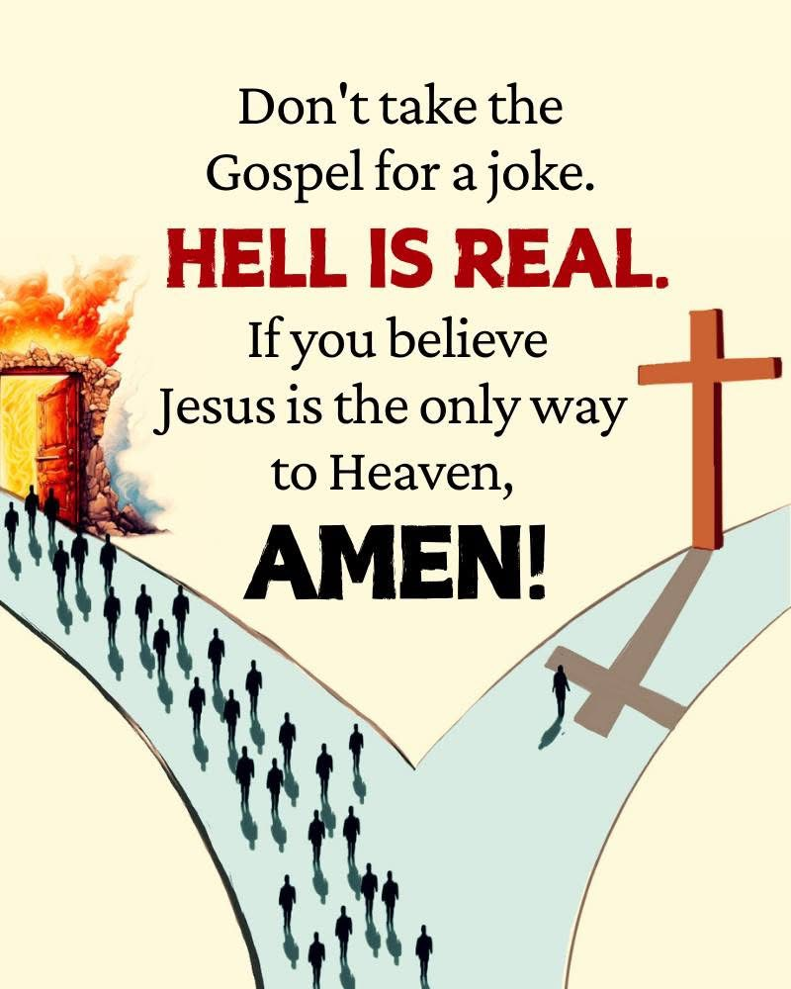

Slide 19
6:16 (5) Believers are the temple of God (1 Cor 3:16; 6:19; Eph 2:21-22). Unbelievers are either worshipers of literal idols or idols in the mind (Eph 5:5) or make themselves like idols.
So, what agreement can there be between these two vastly different sorts of people? Paul refers to some Old Testament verses to show something of the meaning of being the temple of God – Lev 26:11-12; Jer 32:38; Ezek 37:27.

Slide 20
6:17-18 Paul refers to OT Scriptures to give a fitting conclusion to this section. He does not give an exact quotation of any one verse but probably had in mind such verses as Isa 52:11-12; 2 Sam 7:14; Jer 31:9; Isa 43:6.

Slide 21
See the great thing he sets before those who are willing to be a distinct separate holy people. They lose the fellowship and pleasures of the world, but they gain the fellowship of Almighty God. Many people would like to have both, but this is not possible (Jam 4:4).

Slide 22


Slide 23
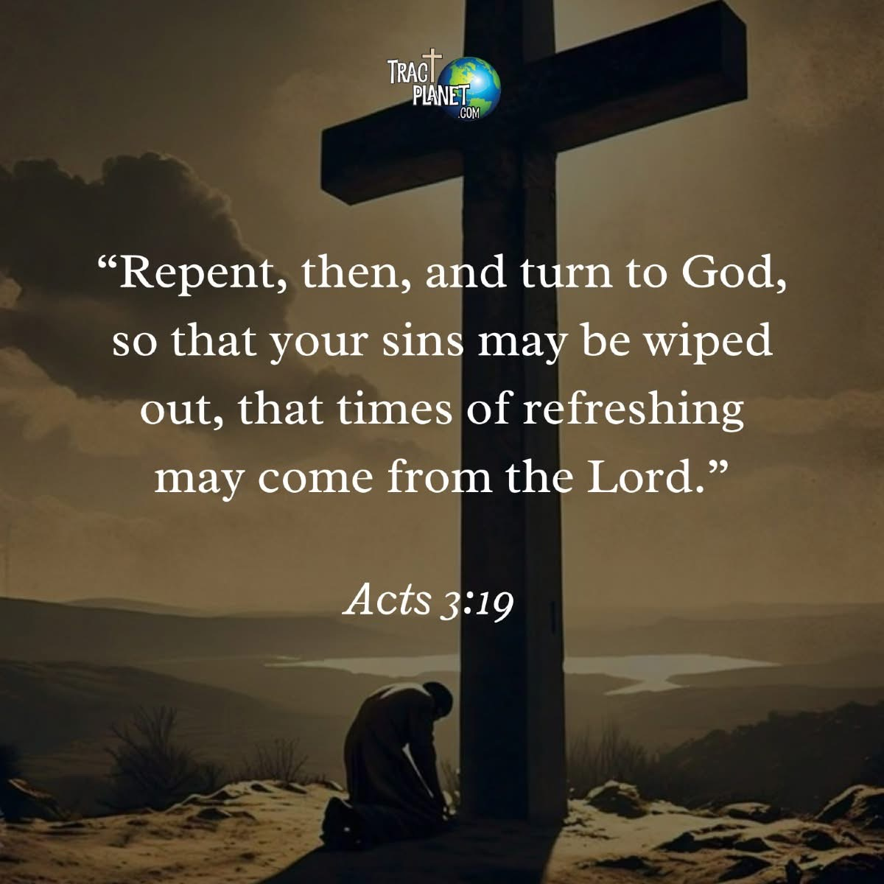

Slide 24
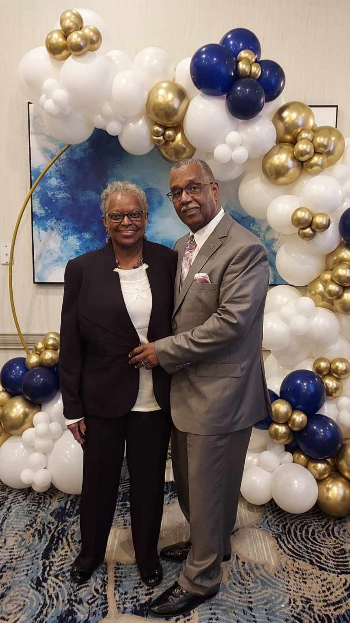
Come Out And Be Separated!
Charity Community Church
1950 Old Cuthbert Road, Suite “K”
Cherry Hill, New Jersey, 08034
Scripture:
2 Cor. 6:14-18
Join us in
Sunday School: 10:00 am
Morning Service: 11:00 am

