Slide 1


Slide 2
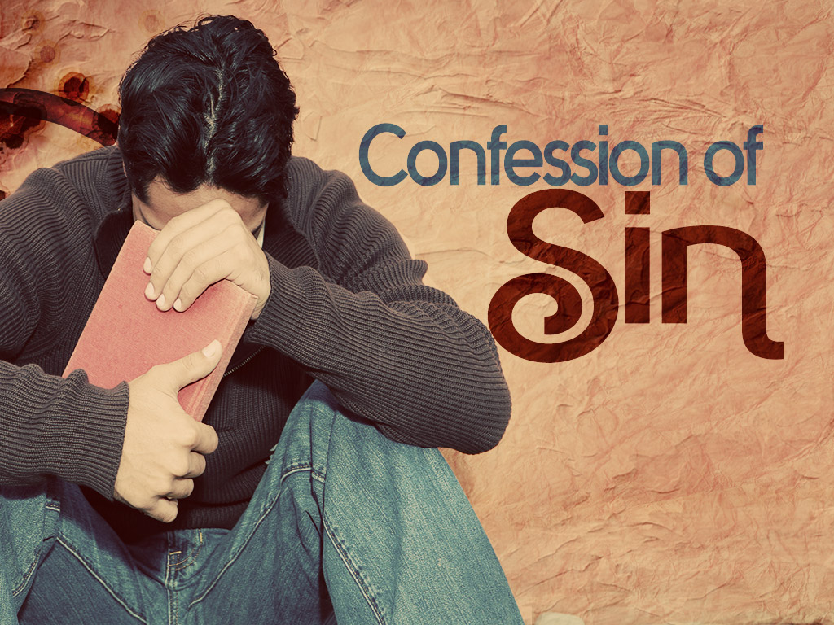
Do Not Continue In
Scripture Text: Hebrews 10:26-31

Slide 3
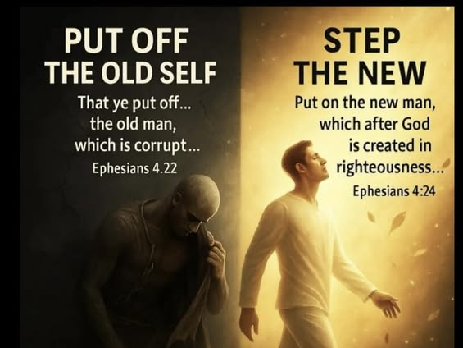

Slide 4

Today is the fourth warning against apostasy. See Heb 2:1-4. This one concerns deliberately sinning against the light of the glorious truth God has revealed through Christ and about Christ.

Slide 5
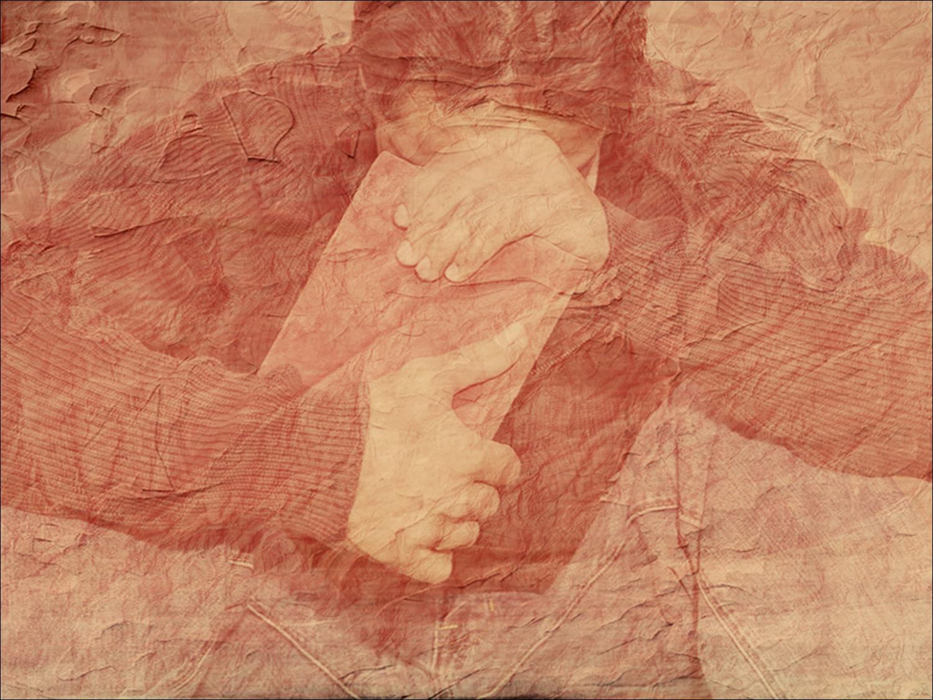
Hebrews 10:26 “Go on sinning”– this describes a state of the heart and life, not one or more acts of sin. The writer does not say that he thinks any of them will fall into this condition. He uses the word “if” (compare Heb 6:6). In v 39 he says he is sure that the believers to whom he is writing will not be guilty of it (compare 1 John 3:9-10).

Slide 6
The writer seems to be referring to one kind of sin in particular. Believers may sin and obtain forgiveness (1 John 5:16). But there is a sin for which there is no forgiveness. Here that sin is described as rejecting Christ and His sacrifice, turning away from the new covenant in His blood, and refusing to obey the voice of God’s Spirit (v 29).

Slide 7

There are those who teach that if believers commit sin they may be lost forever. This is not the teaching of the New Testament – Matt 6:12;1 John 1:9; 2:1.

Slide 8
“Knowledge of the truth”– he does not say “after repentance and faith”. We may have the knowledge of the truth and yet refuse to repent and believe in Christ. The sin about which the writer speaks in this verse may be this continual refusal. That is indicated in the next words.

Slide 9
“No more sacrifice”– if anyone rejects Christ’s sacrifice, he has cut himself off from the one way of forgiveness. And if such a person thinks that he can offer again the OT sacrifices (or any other such sacrifices), and that God will accept them, he is making a grave mistake.

Slide 10
10:27 “Judgment”– Heb 9:27; Acts 17:31; Rev 20:11-15.
“Fiery”– Heb 12:29; 2 Thess 1:7; Matt 3:10; Mark 9:42-48; Luke 16:24; Rev 20:14.

Slide 11
10:29 This is the sin the writer speaks of in v 26. Compare Heb 6:6; Matt 12:31; 1 John 5:16-17. Deliberate sin against the old covenant was punished by death. The new covenant is far greater than the old, so sin against it is far worse than sin against the old. The greater the light and truth God gives, the greater our responsibility to obey it, and the greater the punishment if we do not.

Slide 12


Slide 13
Will a true believer in Christ commit the sin described in this verse – trample Christ under foot, count His blood unholy, etc? It seems impossible in the light of other teaching about believers in the New Testament. See John 5:24; Rom 8:1, 28-33; Phil 1:6; 1 John 3:9-10.

Slide 14
But what about the phrase “the blood... with which he was sanctified?” Can a person be “sanctified” by Christ’s blood and not be a believer, not be saved? The word sanctification does not necessarily imply salvation and faith. The root meaning is to “set apart” (notes at Lev 20:7; John 17:17-19). For a case of unbelievers being sanctified see 1 Cor 7:14.

Slide 15
Let us keep in mind that in this letter we have a comparison of the old and new covenants, and that it was written to Hebrews. They knew that as a nation Israel was sanctified by blood (Heb 9:18-20; Ex 24:7-8; 31:13; Lev 21:8). But this did not at all mean that every individual in Israel was a true believer or saved from God’s wrath – see Heb 3:10-11, 19.

Slide 16
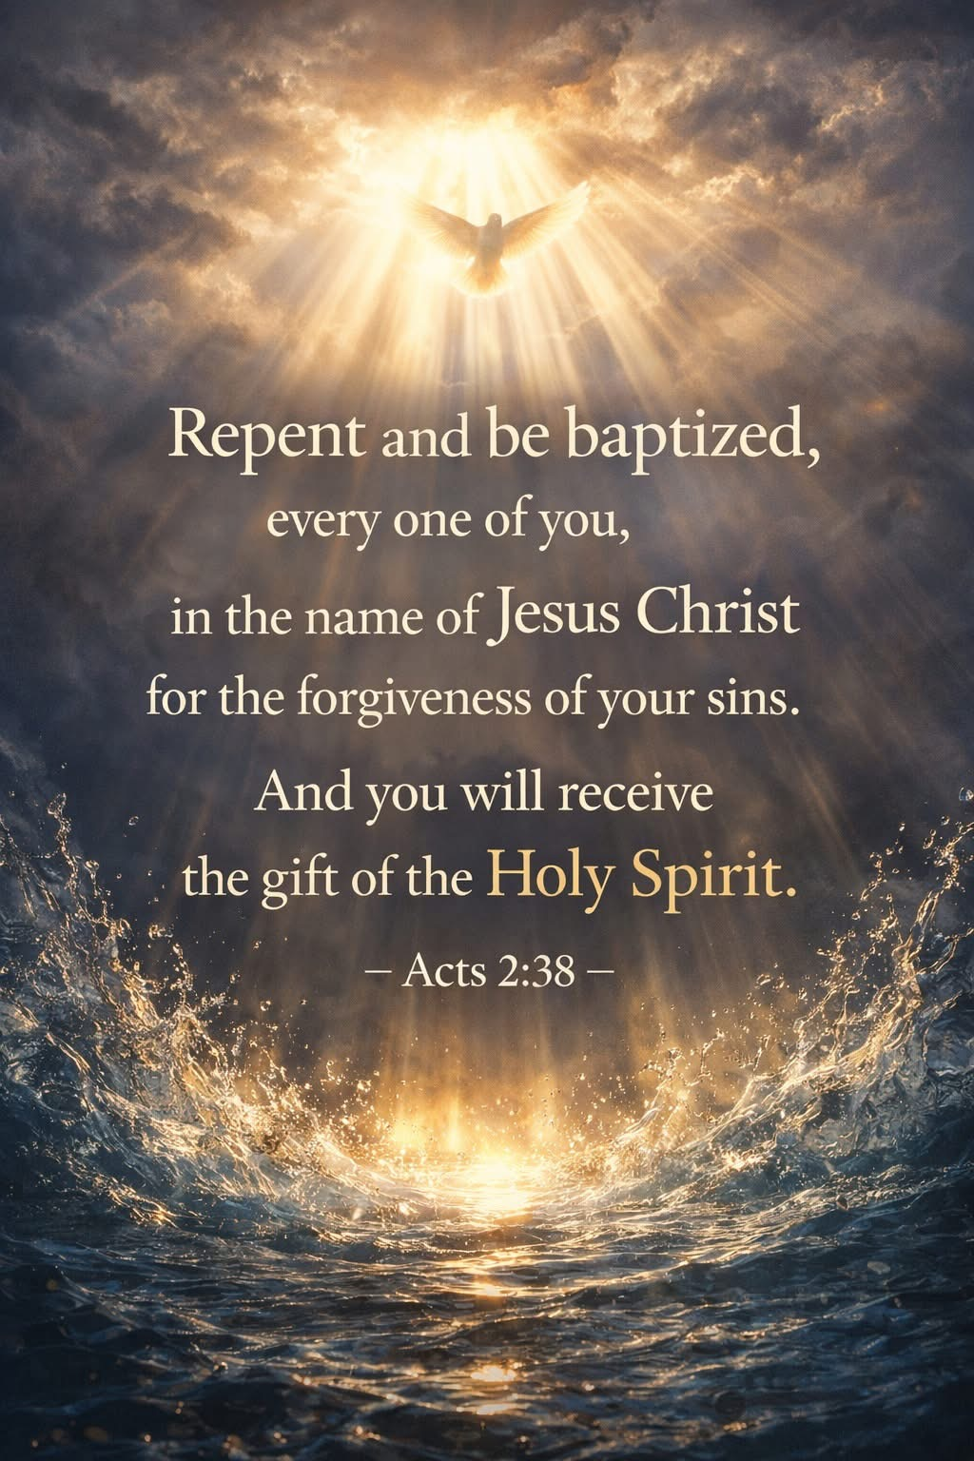

Slide 17
The foundation of the new covenant is Christ’s blood – Heb 9:15. See Heb 13:12, which says that Christ suffered to sanctify “the people” with His own blood. The new covenant was made with the house of Israel – Heb 8:8. The nation of Israel is still set apart (sanctified) from other nations for God’s special purpose (Rom 9:1-5; 11:11, 25-29). But most of them reject Christ and remain without faith and salvation.

Slide 18
And is it not possible to say that the visible church on earth is sanctified by the blood of Christ? And is it not true to say also that a great many in the visible church are unbelieving and have never been saved? See also 1 Tim 2:6, which says that Christ gave Himself as “a ransom” for all who believe. The ransom He gave was Himself, His own blood – 1 Pet 1:18-19.

Slide 19
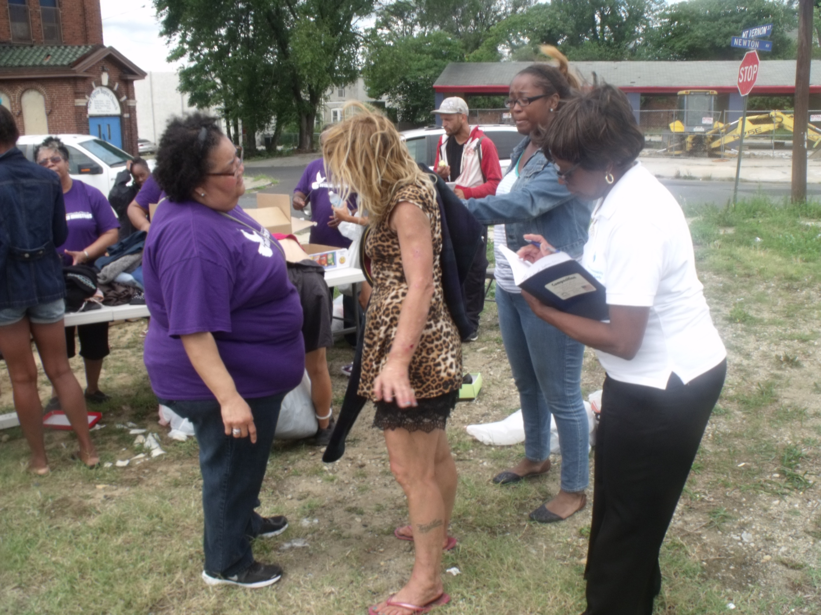
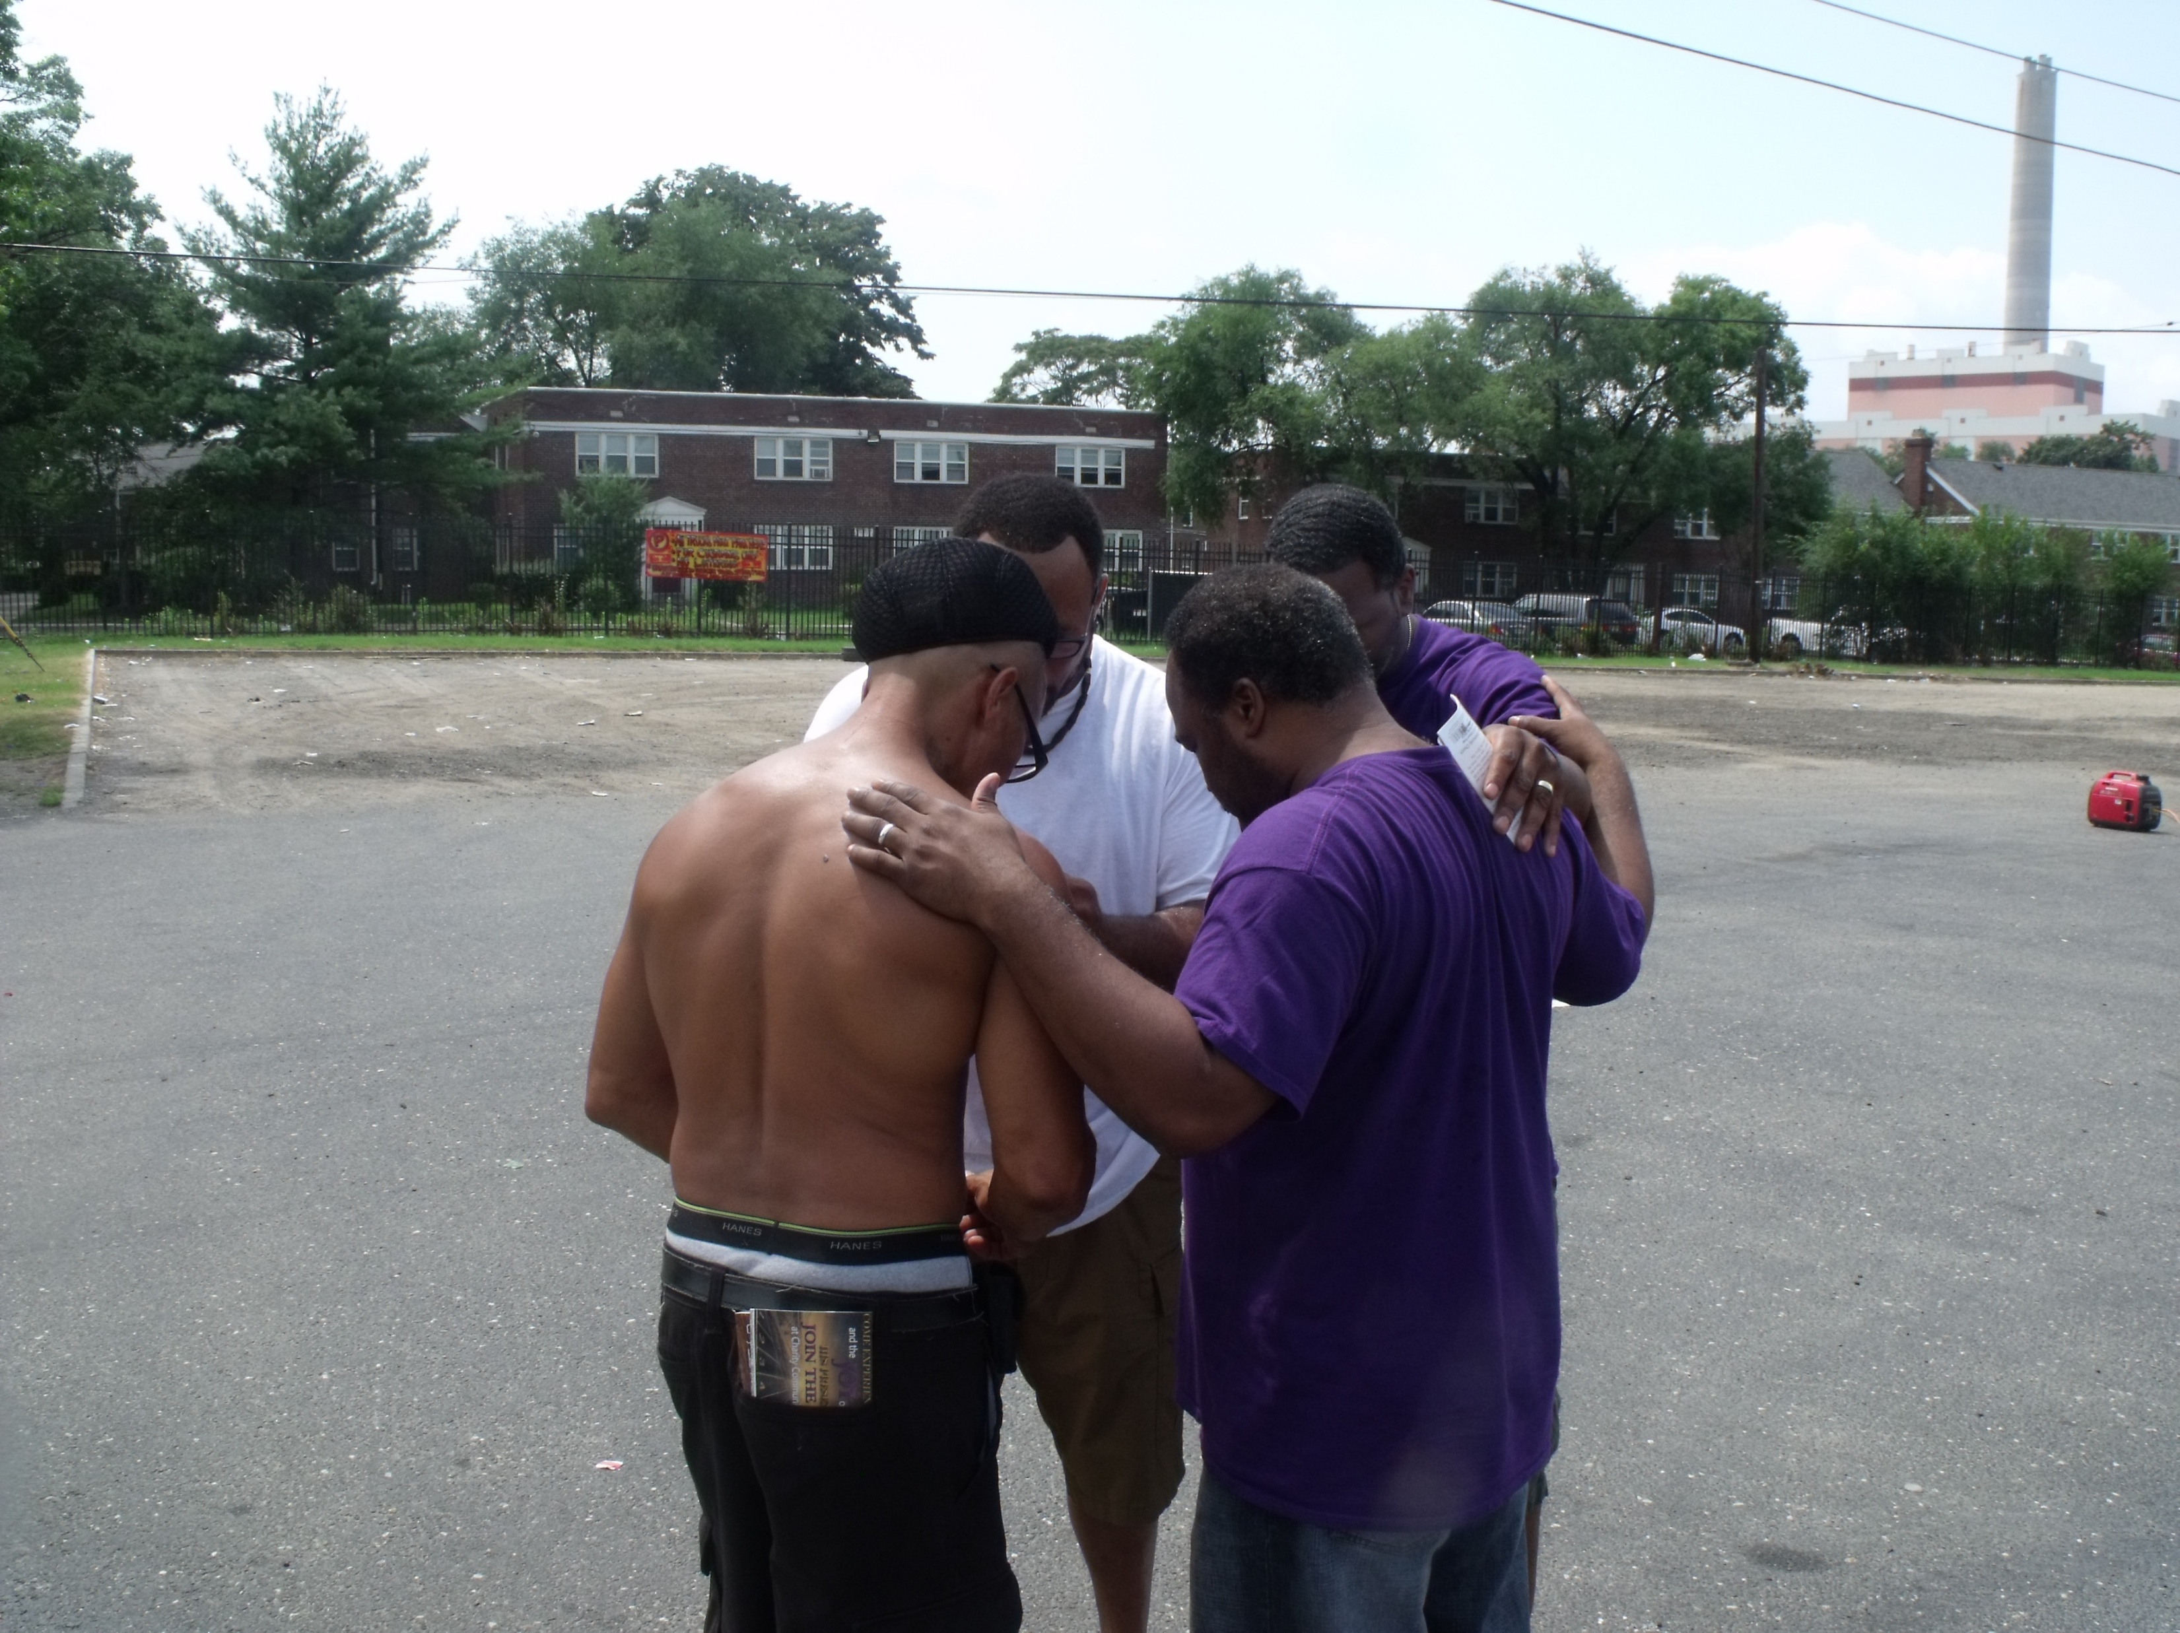

Slide 20
“Adversaries”– he means God’s enemies. Anyone who deliberately rejects the truth God has revealed about Christ and His one sacrifice for sin will find that they are among God’s enemies. Compare John 7:7; 15:18; Rom 5:10; Jam 4:4.

Slide 21
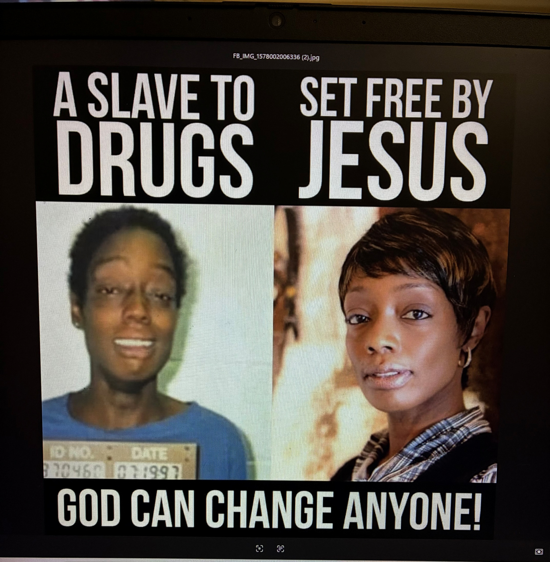

Slide 22
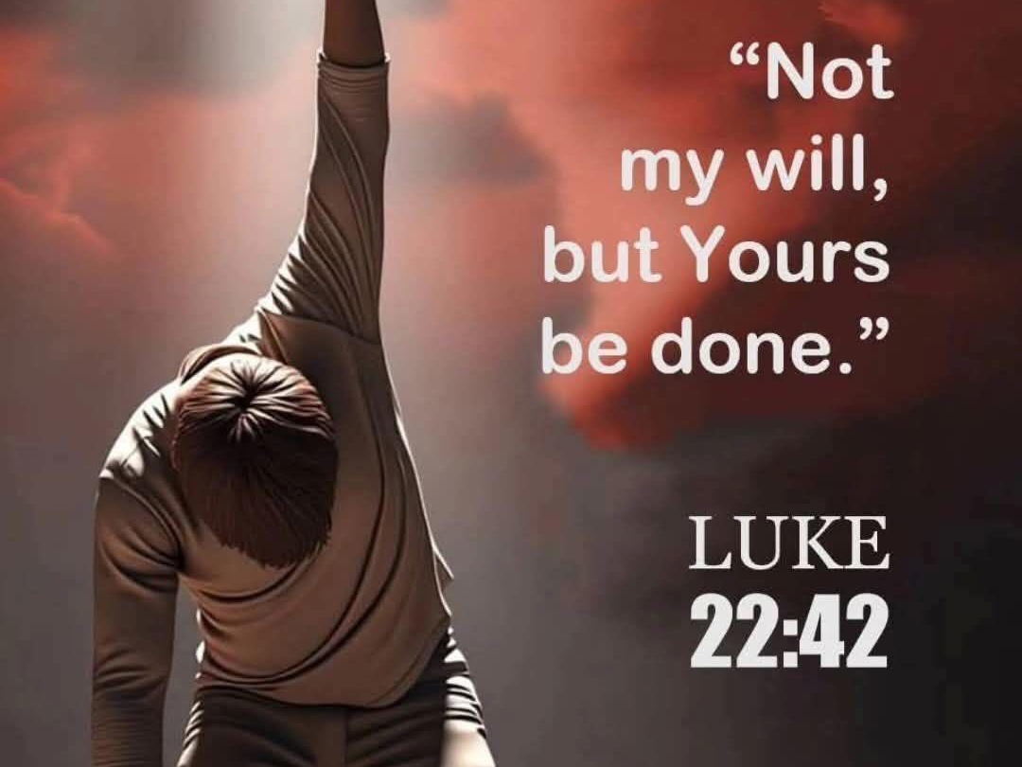

Slide 23
Let us turn from sin and turn to God! THE END!

Slide 24
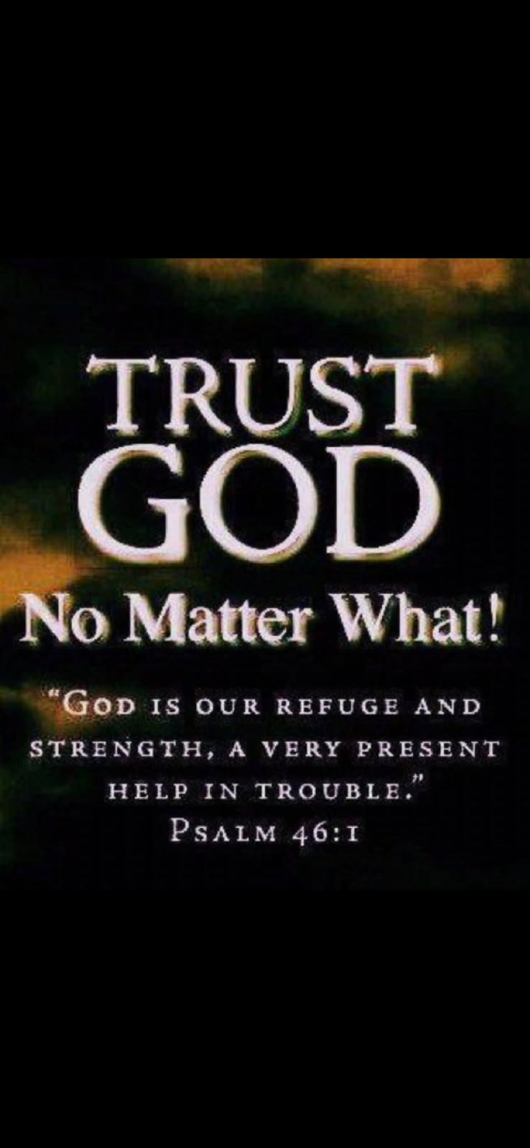
1 John 5:18 - Believers don’t
practice sinning.

Slide 25


