Slide 1

God’s love must be sincere. Hate what is evil; cling to what is good.
Our society has collapsed sexually. We worship at the front of Aphrodite, gobbling up her lavish impurity. Infidelity is common, divorce is rampant, perversion is celebrated, and pornography rages. Sex slavery is increasing across the globe.

Slide 2
Millions of women and children are being sold and imprisoned for men’s pleasure and money. We are groomed to feed our lust on a multiplicity of devices. God forgive us. At the same time, we see the dishonoring of marriage and a generation disenchanted with the concept of creating a bond before God that is not to be broken. Why, in a society like this would a right-minded individual merry? It is an archaic institution. What does a piece of paper mean anymore? Lord help us!

Slide 3

Why Does
GOD
JESUS
A
V
E
S
US?
Scripture Text: 1 John 4:9-10,
I Tim. 2:4, Romans 5:5

Slide 4


Slide 5
1 John 4:9-10 God showed how much he loved us by sending his one and only Son into the world so that we might have eternal life through him. This is real love – not that we loved God, but that he loved us and sent his Son as a sacrifice to take away our sins.
1 Timothy 2:3-4 This is good and pleases God our Savior, who wants everyone to be saved and to understand the truth.

Slide 6
Romans 5:5 And this hope will not lead to disappointment. For we know how dearly God loves us, because he has given us the Holy Spirit to fill our hearts with his love.

Slide 7
BELIEVE IN THE LOVE OF GOD!
It’s so important to realize how much God loves you, because it undergirds your very life as a Christian. Love is always God’s top priority—both for you and through you. You may have often heard that you should love God, but God says, “I love you!” He started it. And when you believe it, it changes your life. Then with that love, you can love others.

Slide 8


Slide 9
God loves you simply because it is His fundamental nature to do so. Rather than being based on your achievements or worthiness, divine love is unconditional. Theology suggests God created you in His image to have a deep relationship with Him, and His love is an expression of His eternal grace.

Slide 10


Slide 11
Theology & Grace: God loves humanity not because we deserve it, but out of inherent grace, exemplifying the concept that "God is love".
Sacrificial Love: In Christian belief, this love is demonstrated through the life and sacrifice of Jesus Christ, prioritizing reconciliation despite human flaws.
Divine Connection: Because you are created in His image and likeness, you are viewed as a unique child of God.

Slide 12
The seven primary characteristics and attributes of God's love include:
For the Gospel
1. Sovereign: God’s love is entirely self-motivated and not forced or obligated by anything outside of His own will.
2. Infinite: His love knows no boundaries, cannot be exhausted, and is measureless.

Slide 13
3. Immutable: It is unchangeable and constant. It is completely unaffected by human inconsistency or the passage of time.
4. Holy: God's love is perfectly pure, righteous, and devoid of any selfishness, sin, or favoritism.
5. Gracious: His love is unearned and unmerited. It is freely given to humanity despite our flaws and failures.

Slide 14
6. Everlasting: It has no beginning and no end. It is a eternal commitment that spans through all generations.
7. Redemptive: It is a sacrificial, active love designed to save and restore humanity into a right relationship with Him.

Slide 15


Slide 16


Slide 17


Slide 18


Slide 20


Slide 21
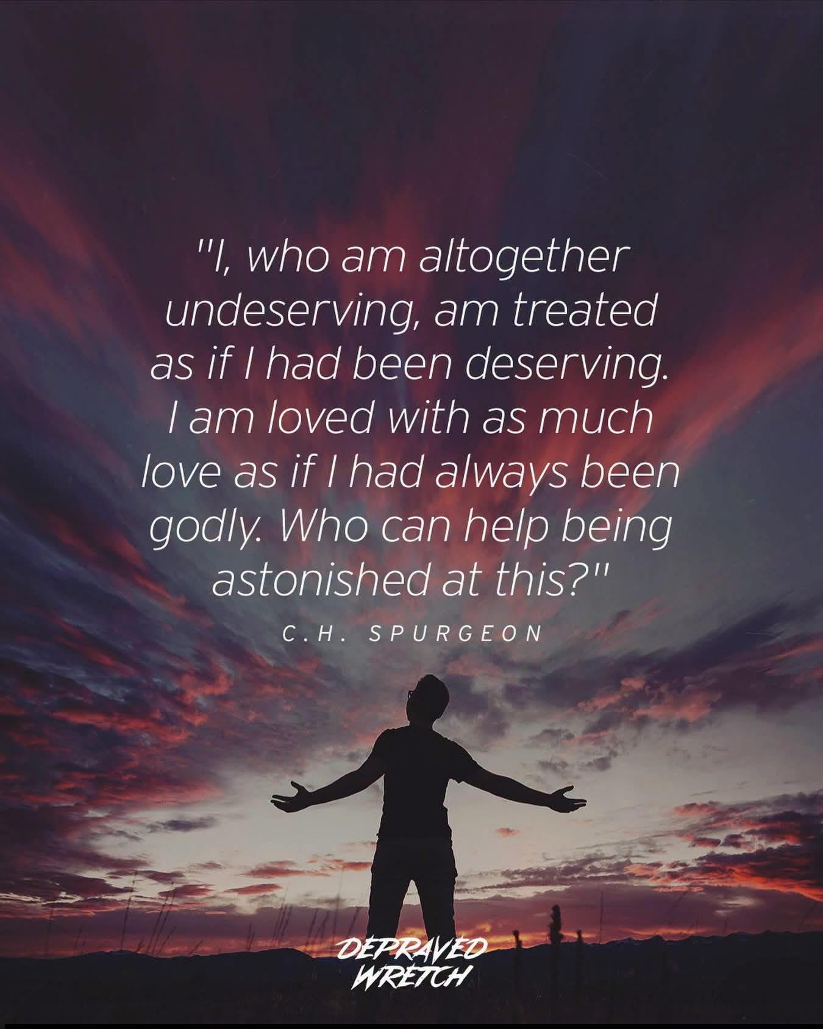

Slide 22
